Slide 1
EE 441 Data Structures
Lecture 12:
Problem Complexity

Slide 2
Remember: Algorithm
An algorithm :
A computable set of steps to achieve a desired result.
precisely specified using an appropriate mathematical formalism--such as a programming language.
Efficiency of an algorithm:
Less consumption of computing resources (execution time (CPU cycles), memory)
We will focus on time efficiency

Slide 3
How to find a guaranteed solution
Brute force: For many non-trivial problems, there is a natural brute force search algorithm that checks every possible solution.
Typically takes 2^{N} time or worse for inputs of size N.
Unacceptable in practice.

Slide 4
Desirable Scaling Property
There exist constants c > 0 and d > 0 such that on every input of size N, its running time is bounded by c N^{d} steps.
Polynomial time!
These are the algorithms that are practical to run

Slide 5
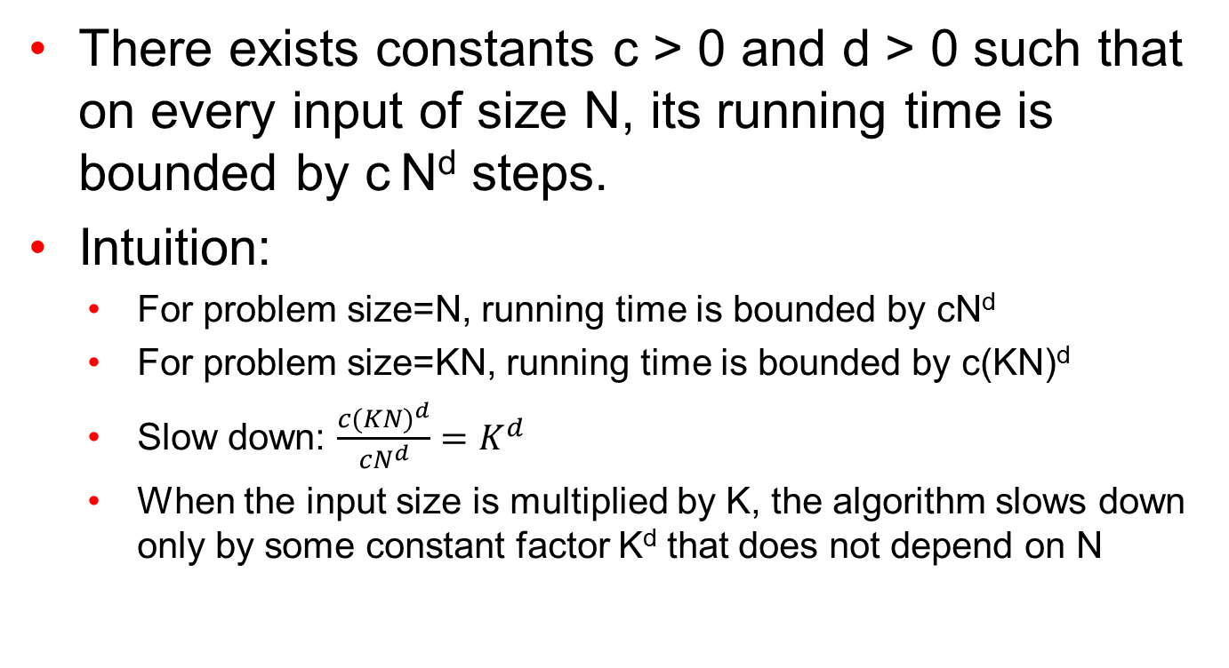
Desirable Scaling Property
There exists constants c > 0 and d > 0 such that on every input of size N, its running time is bounded by c N^{d} steps.
Intuition:
For problem size=N, running time is bounded by cN^{d}
For problem size=KN, running time is bounded by c(KN)^{d}
Slow down: $\frac{c{(KN)}^{d}}{{cN}^{d}}=K^{d}$
When the input size is multiplied by K, the algorithm slows down only by some constant factor K^{d} that does not depend on N

Slide 6
Desirable Scaling Property
Q: How does the algorithm slow down if it is exponential?
Its running time is bounded by c B^{N} steps.
When the input size is multiplied by K, how does the algorithm slow down?

Slide 7
Algorithm vs Problem Complexity
The algorithmic complexity of a computation is some measure of how difficult is to perform the computation (i.e., specific to an algorithm)
The complexity of a computational problem or task is the complexity of the algorithm with the lowest order of growth of complexity for solving that problem or performing that task.
e.g. the problem of searching an ordered list has at most lgn time complexity.
Computational Complexity: deals with classifying problems by how hard they are.

Slide 8
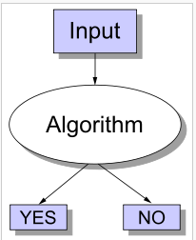
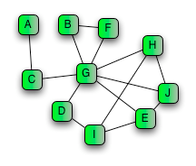
Problem Classification
Decision Problems: Problems are formalized as questions with Yes/No answers
Example: Does a path exist between node A and E with at most 3 edges?
Optimization problems can be converted to decision problems:
Find a path between A and E that uses the fewest edges

Slide 9
Decision Problem Example
Clique Problem:
Undirected graph G = (V, E)
Clique: a subset of vertices in V all connected to each other by edges in E (i.e., forming a complete graph)
Size of a clique: number of vertices it contains
Optimization problem:
Find a clique of maximum size
Decision problem:
Does G have a clique of size k?
Clique(G1, 2) = YES
Clique(G1, 3) = NO
Clique(G2, 3) = YES
Clique(G2, 4) = NO

Slide 10
Class P problems
Class P consists of (decision) problems that are solvable in polynomial time
Polynomial-time algorithms
Worst-case running time is O(n^{k}), for some constant k
Examples of polynomial time:
O(n²), O(n³), O(1), O(n log n)
Examples of non-polynomial time:
O(2^{n}), O(n^{n}), O(n!)

Slide 11
Class P problems
Example: String Matching is a Decision problem.
X is a set of strings.
Instance: string s.
Question: Is string s in set X?
Algorithm A solves problem X: A(s) = yes iff s ∈ X.
Algorithm A runs in poly-time:
for every string s, A(s) terminates in at most p(|s|) "steps“
p(⋅) is some polynomial and |s| is the length of s

Slide 12
Tractable/Intractable Problems
Problems in P are also called tractable
Problems not in P are intractable or unsolvable
Can be solved in reasonable time only for small inputs
Or, can not be solved at all
Are non-polynomial algorithms always worse than polynomial algorithms?
- n^{1,000,000} is technically tractable, but really impossible
- n^{log log log n} is technically intractable, but easy

Slide 13
Example of Unsolvable Problem
Turing discovered in the 1930’s that there are problems unsolvable by any algorithm.
The most famous of them is the halting problem
Given an arbitrary algorithm and its input, will that algorithm eventually halt, or will it continue forever in an “infinite loop?”
Example:
main(){while(true){}; } does not halt; rather, it goes on forever in an infinite loop
main(){cout<<“EE441”;} halts very quickly.
A more complex program might be more difficult to analyze. The program could be run for some fixed time. If the program does not halt, there is in general no way to know if the program will eventually halt or run forever.

Slide 14
Classification of Problems
Problems can be classified in various categories based on their degree of difficulty, e.g.,
P: problems solvable in poly time (tractable)
NP: problems verifiable in poly time.
NP-complete
NP-hard
Intractable

Slide 15
NP Algorithms
Nondeterministic algorithm = two stage procedure:
Nondeterministic (“guessing”) stage:
generate randomly an arbitrary string that can be thought of as a candidate solution (“certificate”)
Deterministic (“verification”) stage:
take the certificate and the instance to the problem and return YES if the certificate represents a solution
NP algorithms (Nondeterministic polynomial)
verification stage is polynomial

Slide 16
Class of “NP” Problems
Class NP consists of problems that could be solved by NP algorithms
i.e., verifiable in polynomial time
If we were given a “certificate” of a solution, we could verify that the certificate is correct in time polynomial to the size of the input
Warning: NP does not mean “non-polynomial”

Slide 17
Certifier
X is a solution set
We want to know if s∈X
Certifier Algorithm C(s,t) is a certifier for String Matching problem if for every string s, s∈X iff there exists a string t such that C(s,t)=yes.
Intuition about Certification algorithm
Certifier doesn’t determine whether s ∈ X on its own.
Certifier checks a proposed proof t that s ∈ X.
Certificate: Instance which leads the true answer.

Slide 18
Certifier Example 1
Composites: Given integer s, is s composite (i.e. not a prime) ?
Solution set: Set of all composite numbers
Certificate: A nontrivial factor t of s. Note that such a certificate exists iff s is composite. Moreover |t| ≤ |s|
Certifier: C(s,t) that if s is a multiple of t, return true, but otherwise return false.
Instance: s = 437,669
Certificate: t = 541 or 809 results in (437,669 = 541 * 809)

Slide 19
Certifier Example 2
SAT: Given any Boolean formula, is there a satisfying assignment?
Solution set: Input combinations that produce a true value
Certificate: An assignment of truth values to the n Boolean variables.
Certifier: Check that each clause in has at least one true literal.
Instance: Φ =x₁(x₂’+x₃x₄)(x₁’+x₄x₅’) : A Boolean formula
Certificate: x₁=1, x₂=0, x₃=1, x₄=1, x₅=0, there may exist such other certificates
Instance: Φ =x₁(x₂’+x₃x₄)(x₁’+x₄’ ): Another Boolean formula
Certificate: No assignment resulting in YES answer

Slide 20
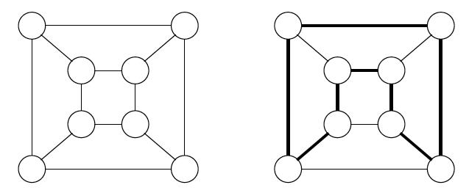
Certifier Example 3
HAM-CYCLE: Given an undirected graph G=(V,E), does there exist a simple cycle C that visits every node?
Certificate: A permutation of the n nodes.
Certifier: Check that the permutation contains each node in V exactly once, and that there is an edge between each pair of adjacent nodes in the permutation.
An Instance and Certificate:
Instance s
Certificate t

Slide 21
Relationships
Remember the notation:
X is a set of strings.
Instance: string s.
Algorithm A solves problem X: A(s) = yes iff s ∈ X.
Algorithm A runs in poly-time if for every string s, A(s) terminates in at most p(|s|) "steps", where p(⋅) is some polynomial and |s| is the length of s.
Certifier Algorithm C(s,t) is a certifier for problem X if for every string s, s∈X iff there exists a string t such that C(s,t)=yes.
P: Decision problems for which there is a poly-time algorithm.
EXP: Decision problems for which there is an exponential-time algorithm (O(r^{n}))
NP: Decision problems for which there is a poly-time certifier.

Slide 22
Relationships
P ⊆ NP
Proof: Consider any problem X in P.
By definition, there exists a poly-time algorithm A(s) that solves X.
Certificate: t = ε, certifier C(s, t) = A(s).
Certifier is the algorithm itself!
NP ⊆ EXP
Proof: Consider any problem X in NP.
By definition, there exists a poly-time certifier C(s, t) for X.
To solve input s, run C(s, t) on all strings t with |t| ≤ p(|s|).
How many such strings are there????
Return yes, if C(s, t) returns yes for any of these.
EXP
P
NP

Slide 23
Relationships
The big (and open question) is whether NP ⊆ P or P = NP
i.e., if it is always easy to check a solution, should it also be easy to find a solution?
Most computer scientists believe that this is false but we do not have a proof …
Clay $1 million prize.
EXP
P
NP
If P=NP➔Generation is as easy as recognition:
Writing Shakespeare is as easy as recognizing Shakespeare.

Slide 24
NP-Completeness (informally)
NP-complete problems are defined as the hardest problems in NP
Most practical problems turn out to be either P or NP-complete.
P
NP-complete
NP

Slide 25
Reductions
Reduction is a way of saying that one problem is “easier” than another.
We say that problem A is easier than problem B, (i.e., we write “A ≤ B”)
if we can solve A using the algorithm that solves B.
Idea: transform the inputs of A to inputs of B
yes
α
f
β
Problem B
yes
no
no
Problem A

Slide 26
Polynomial Reductions
Given two problems A, B, we say that A is polynomially reducible to B (A ≤_{p} B) if:
There exists a function f that converts the input of A to inputs of B in polynomial time
A(i) = YES ⇔ B(f(i)) = YES
yes
α
f
β
Problem B
yes
no
no
Problem A

Slide 27
Polynomial Reduction Example: Vertex Cover Problem
Vertex cover problem:
Let G=(V,E) be a graph where V={v₁, v₂,..,v_{N}} is the vertices and E={(v_{i},v_{j})} is the edges of the graph.
Example:
V={a,b,c,d,e}
E={(a,b),(b,d),(b,e),(c,e),(d,e)}
Cover C of G is a subset of V such that for each edge (v_{i}, v_{j}) in E, either v_{i} or v_{j} is in C.
A minimum cover of G is a set C* such that the number of nodes in C* is the minimum among all the covers of G, that is ⏐C*⏐≤⏐C⏐.
Given a graph G, the Vertex Cover problem tries to find a minimal cover.
a
b
c
d
e

Slide 28
Polynomial Reduction Example: Vertex Cover Problem
a
b
All Covers:
C₁={a,b,c,d,e}
C₂={a,b,c,d}
C₃={a,b,c,e}
C₄={a,b,d,e}
C₅={a,c,d,e}
C₆={b,c,d,e}
C₇={a,b,e}
C₈={a,d,e}
C₉={b,c,d}
C₁₀={b,c,e}
C₁₁={b,d,e}
C₁₂={b,e}
Minimal Cover: C₁₂={b,e}
c
d
e

Slide 29
Polynomial Reduction Example: k-Clique Problem
Clique Problem:
Undirected graph G = (V, E)
Clique: a subset of vertices in V all connected to each other by a subset of edges E (i.e., forming a complete graph)
Size of a clique: number of vertices it contains
Optimization problem:
Find a clique of maximum size
Decision problem:
Does G have a clique of size k?
Clique(G, 2) = YES
Clique(G, 3) = NO
Clique(G, 3) = YES
Clique(G, 4) = NO

Slide 30
Polynomial Reduction Example
Reducing k-clique to vertex cover in P
The complement G_{C} of a graph G contains exactly those edges not in G
Compute G_{C} in polynomial time
G has a clique of size k iff G_{C} has a vertex cover of size |V| - k
The reverse is also true for this example, that is vertex cover can be reduced to k-clique by applying the same algorithm.

Slide 31
Polynomial Reduction Example: k-clique to Vertex cover
a
a
G1
G1 has a clique: {a,b,c} size 3
G1_{C} has a vertex cover {d} of 1 which is
|V| - k=4-3
G1_{C}
b
b
c
c
d
d
a
G2
a
G2 has a clique: {a,b,c} size 3
G2_{C} has a vertex cover {d,e} of size 2=5-3
G2_{C}
b
c
b
c
d
e
d
e

Slide 32
NP-Completeness (formally)
A problem B is NP-complete if:
(1) B ∈ NP
(2) A ≤_{p} B for all A ∈ NP
No polynomial time algorithm has been discovered for an NP-Complete problem
No one has ever proven that no polynomial time algorithm can exist for any NP-Complete problem
A₁
NP-C
P
B
A₂
A₃
NP
A₄

Slide 33
Implications of Reduction
yes
α
f
β
Problem B
yes
no
no
Problem A
- If A ≤_{p} B and B ∈ P, then A ∈ P
- if A ≤_{p} B and A ∉ P, then B ∉ P

Slide 34
Proving Polynomial time
Polynomial time algorithm to decide A
yes
α
f
β
Polynomial time
algorithm to decide B
yes
no
no
We know B is polynomial. We want to prove A is polynomial.
Use a polynomial time reduction algorithm to
transform A into B
Run a known polynomial time algorithm for B
Use the answer for B as the answer for A

Slide 35
NP-Hard (formally)
A problem B is NP-complete if:
(1) B ∈ NP
(2) A ≤_{p} B for all A ∈ NP
If B satisfies only property (2) we say that B is NP-hard
A₁
NP-C
B
P
A₂
NP-H
A₃
NP
A₄

Slide 36
Proving NP Completeness
If A is NP-Complete and A ≤_{p} B
⇒ B is NP-Hard
In addition, if B ∈ NP
⇒ B is NP-Complete
Proof: Assume that B ∈ P
Since A ≤_{p} B ⇒ A ∈ P contradiction!
⇒ B is NP-Hard

Slide 37
Proving NP-Completeness
Theorem: If B is NP-complete, and
C ∈ NP
B ≤_{p} C
then C is NP-complete.
In other words, we can prove a new problem is NP-complete by reducing some other NP-complete problem to it.
Proof: Let A be any problem in NP. Since B is NP-complete, A≤_{p}B . By assumption, B ≤_{p} C. Therefore: A ≤_{p} B ≤_{p} C, which implies by transitivity A ≤_{p} C
NP-C
P
A₁
A₂
B
C
A₃
NP
A₄

Slide 38
Proving NP-Completeness In Practice
Prove that the problem B is in NP
A randomly generated string can be checked in polynomial time to determine if it represents a solution
Show that one known NP-Complete problem can be transformed to B in polynomial time
No need to check that all NP-Complete problems are reducible to B
If any NP-Complete problem can be solved in polynomial time ⇒ then P = NP.

Slide 39
Why discussion on NP-Completeness
If a problem is proved to be NP-Complete, a good evidence for its intractability (hardness).
Do not waste time on trying to find efficient algorithm for it
Instead, focus on design approximate algorithm or a solution for a special case of the problem (HEURISTIC)
Some problems looks very easy on the surface, but in fact, is hard (NPC).

Slide 40
NP-naming convention
NP-complete - means problems that are 'complete' in NP, i.e. the most difficult to solve in NP
NP-hard - stands for 'at least' as hard as NP (but not necessarily in NP);
NP-easy - stands for 'at most' as hard as NP (but not necessarily in NP);
NP-equivalent - means equally difficult as NP, (but not necessarily in NP);

Slide 41
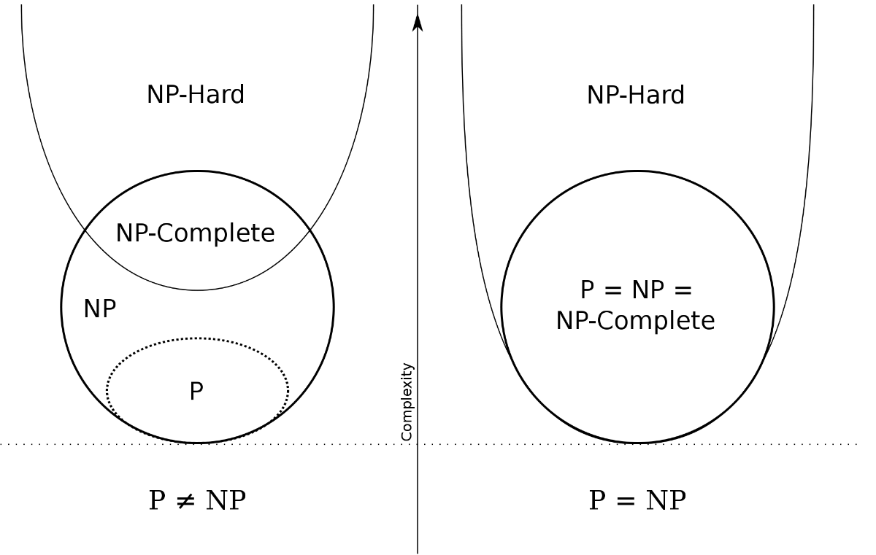
NP-naming convention

Slide 42
P & NP-Complete Problems
Shortest simple path
Given a graph G = (V, E) find a shortest path from a source to all other vertices
Polynomial solution: O(VE)
Longest simple path
Given a graph G = (V, E) find a longest path from a source to all other vertices
NP-complete

Slide 43
P & NP-Complete Problems
Euler tour
G = (V, E) a connected, directed graph find a cycle that traverses each edge of G exactly once (may visit a vertex multiple times)
Polynomial solution O(E)
Hamiltonian cycle
G = (V, E) a connected, directed graph find a cycle that visits each vertex of G exactly once
NP-complete

Slide 44
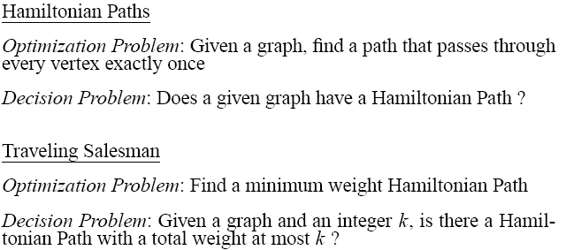
Examples NP-complete and NP-hard problems
NP-complete
NP-hard

Slide 45
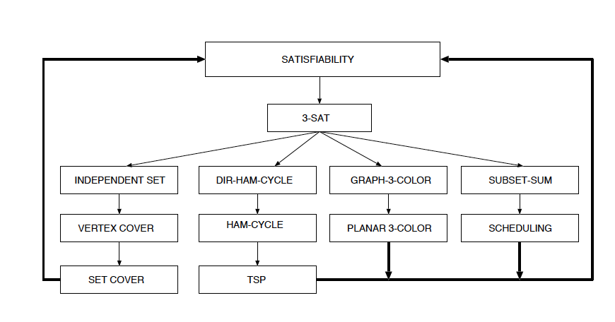
Examples NP-complete and NP-hard problems
All problems in figure below are NP-complete and polynomially reduce to one another

Slide 46
EE 441 Data Structures
Lecture 3:
Algorithm and Problem Complexity

